Slide 1
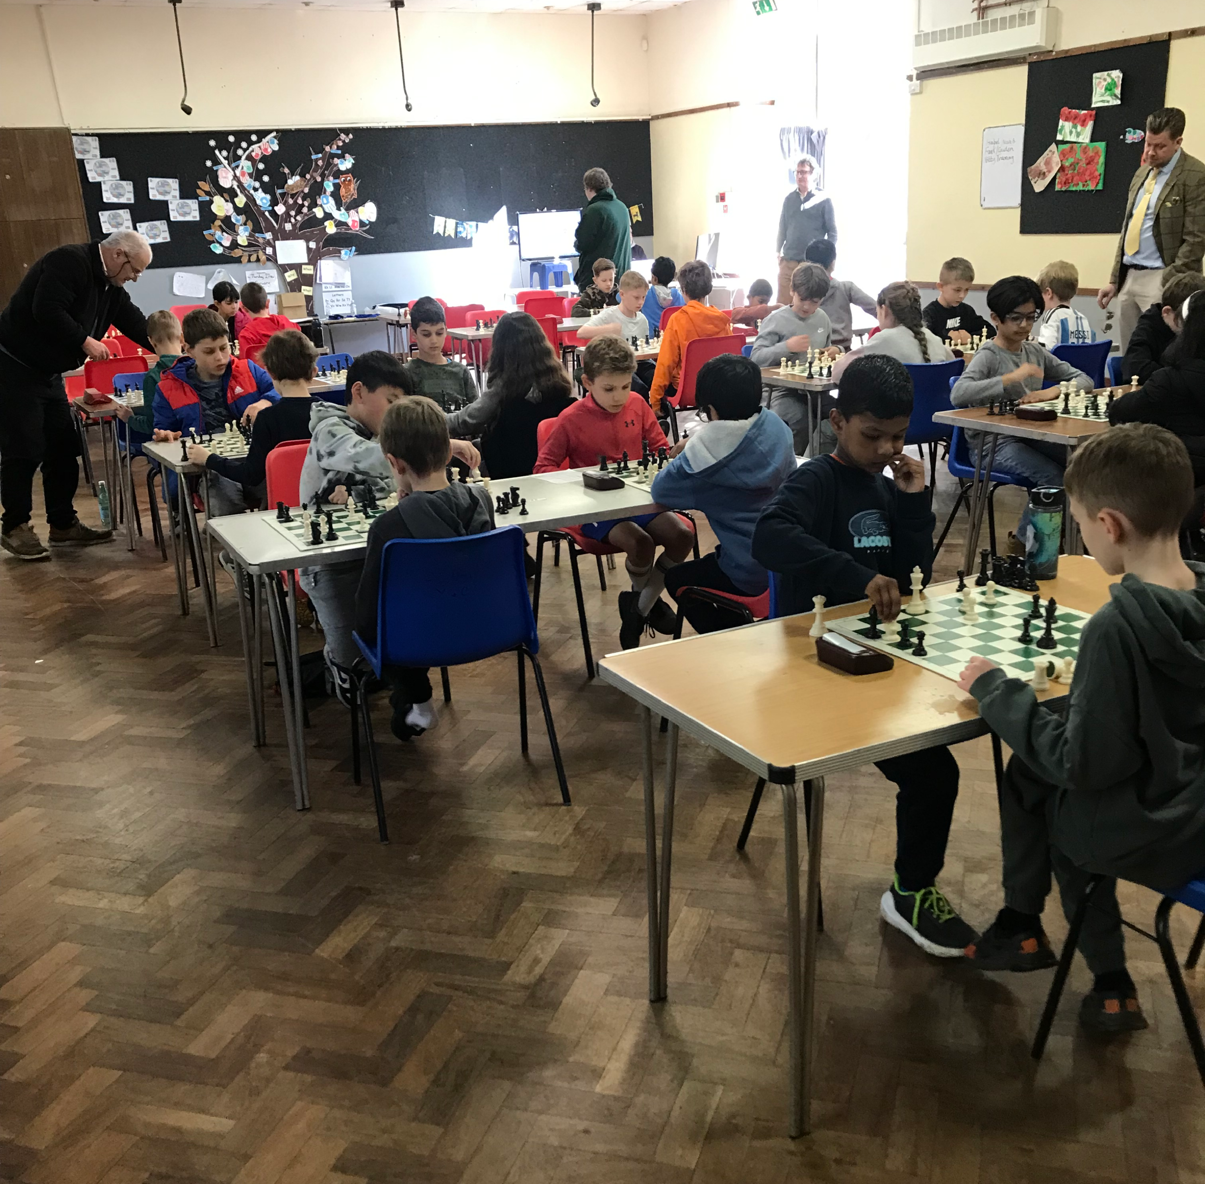
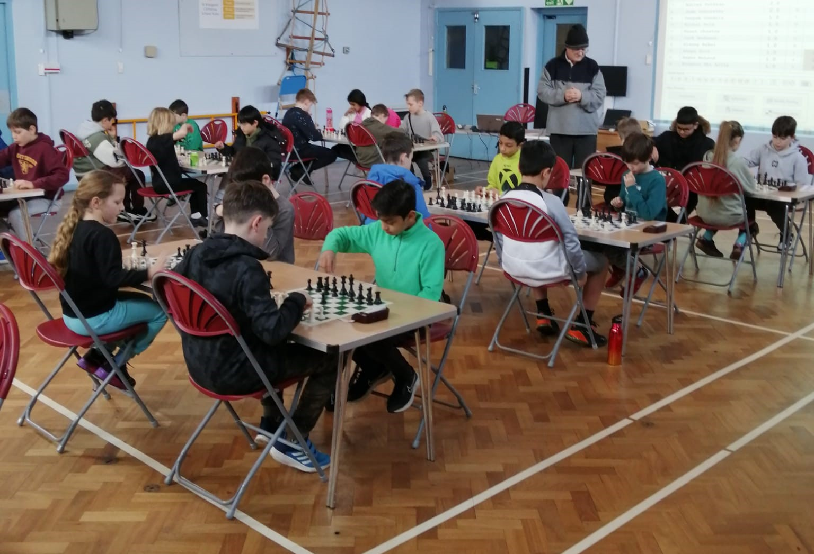
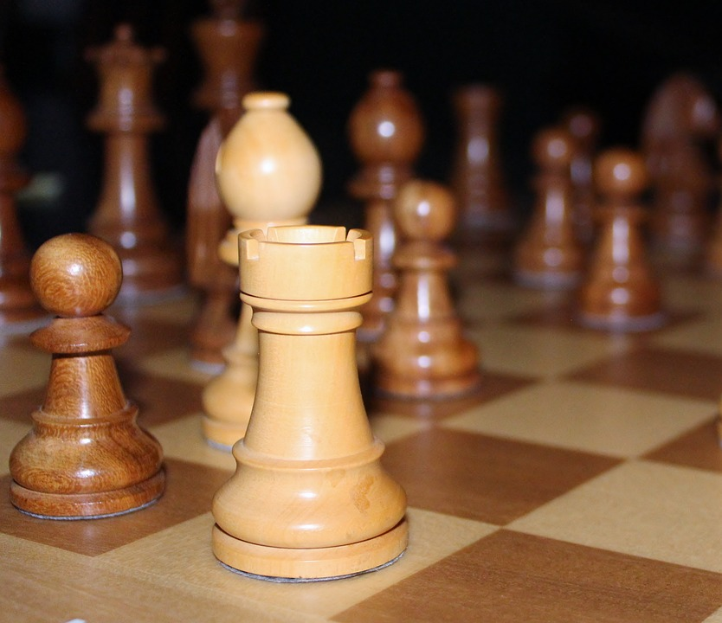
Bracknell Chess Club Family and Children Group 2025 - 2026
For family and children (under-18) of any chess playing ability. Meets 6.15 – 7.15 pm Thursday evenings September 2025 – July 2026 at the Hanworth Community Centre, Hanworth Road, Bracknell Berks RG12 7WX. £30 per family. Includes coaching by an ECF approved chess tutor, monthly ‘improver’ training 7.00 – 8.00 pm and free entry to LCC and EJCOA tournaments (5 planned). Contact infobracknellchessclub@btinternet.com for further information.

Slide 2
Bracknell Chess Club Family and Children Group 2025 - 2026
For family and children (under-18) of any chess playing ability. Meets 6.15 – 7.15 pm Thursday evenings September 2025 – July 2026 at the Hanworth Community Centre, Hanworth Road, Bracknell Berks RG12 7WX. £30 per family. Includes coaching by an ECF approved chess tutor, monthly ‘improver’ training 7.00 – 8.00 pm and free entry to LCC and EJCOA tournaments (5 planned). Contact infobracknellchessclub@btinternet.com for further information.

Slide 3
Bracknell Chess Club Family and Children Group 2025 - 2026
For family and children (under-18) of any chess playing ability. Meets 6.15 – 7.15 pm Thursday evenings September 2025 – July 2026 at the Hanworth Community Centre, Hanworth Road, Bracknell Berks RG12 7WX. £30 per family. Includes coaching by an ECF approved chess tutor, monthly ‘improver’ training 7.00 – 8.00 pm and free entry to LCC and EJCOA tournaments (5 planned). Contact infobracknellchessclub@btinternet.com for further information.

Slide 4
Bracknell Chess Club Family and Children Group 2025 - 2026
For family and children (under-18) of any chess playing ability. Meets 6.15 – 7.15 pm Thursday evenings September 2025 – July 2026 at the Hanworth Community Centre, Hanworth Road, Bracknell Berks RG12 7WX. £30 per family. Includes coaching by an ECF approved chess tutor, monthly ‘improver’ training 7.00 – 8.00 pm and free entry to LCC and EJCOA tournaments (5 planned). Contact infobracknellchessclub@btinternet.com for further information.

