Slide 1
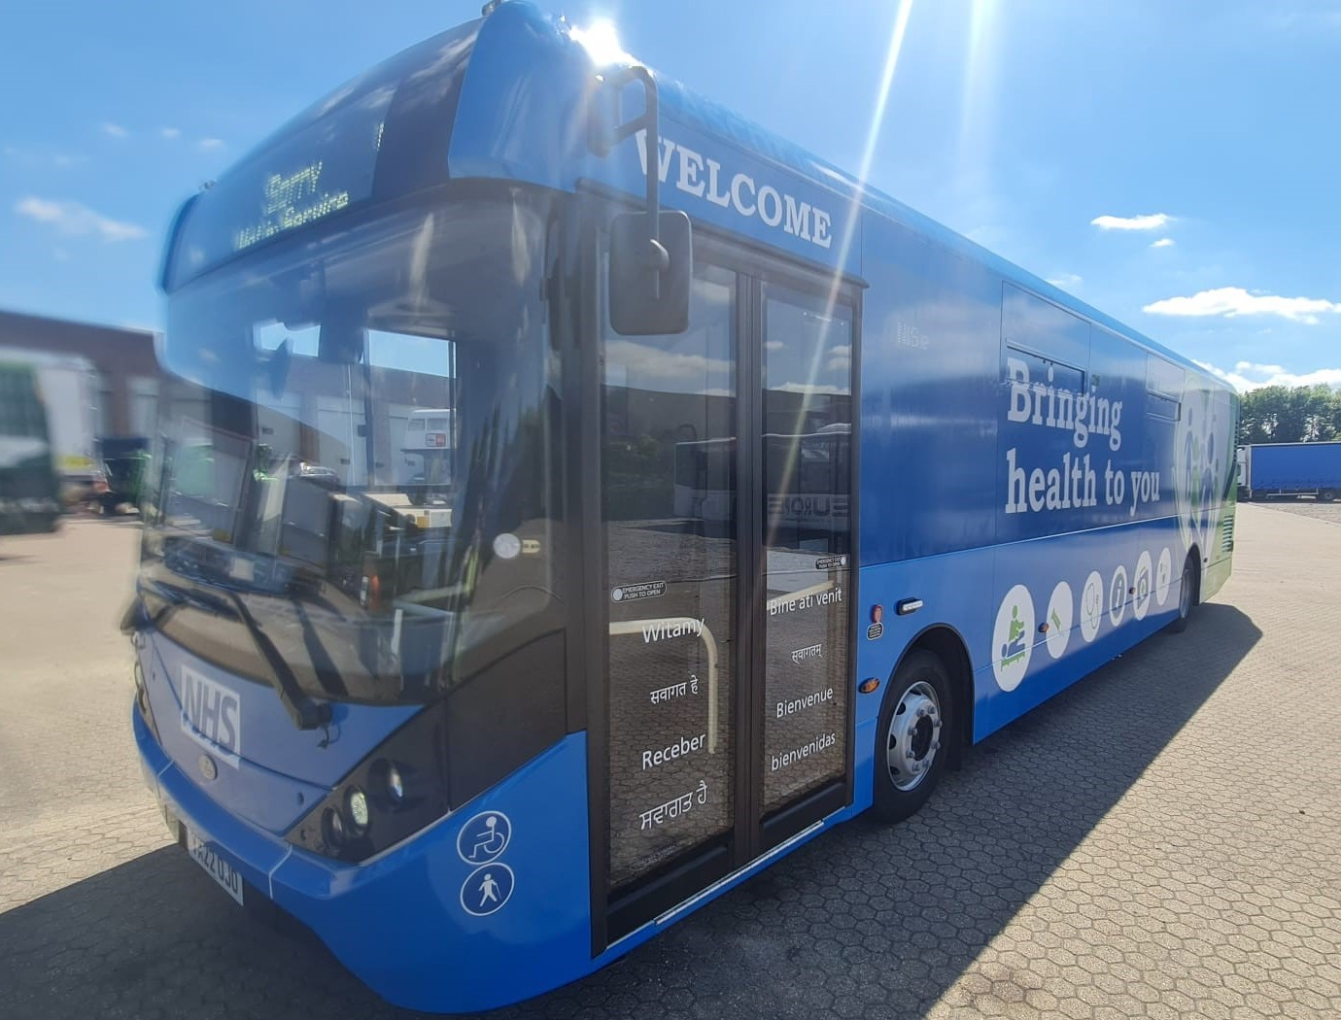
Come Talk to us About your 5-18yr Child’s Vaccines!
This year the School Aged Immunisation Team will also be visiting an area near you on our Health Bus.
To Talk
To Give Consent
To Vaccinate
Child Friendly Environment
Translation Services Available
At Norreys Church, RG40 1UU On 30/11/22

