Slide 1
Oaklands Junior School Online Safety
Presentation for parents
September 2022
Thanks to Childnet/ UK Safer Internet Centre

Slide 11
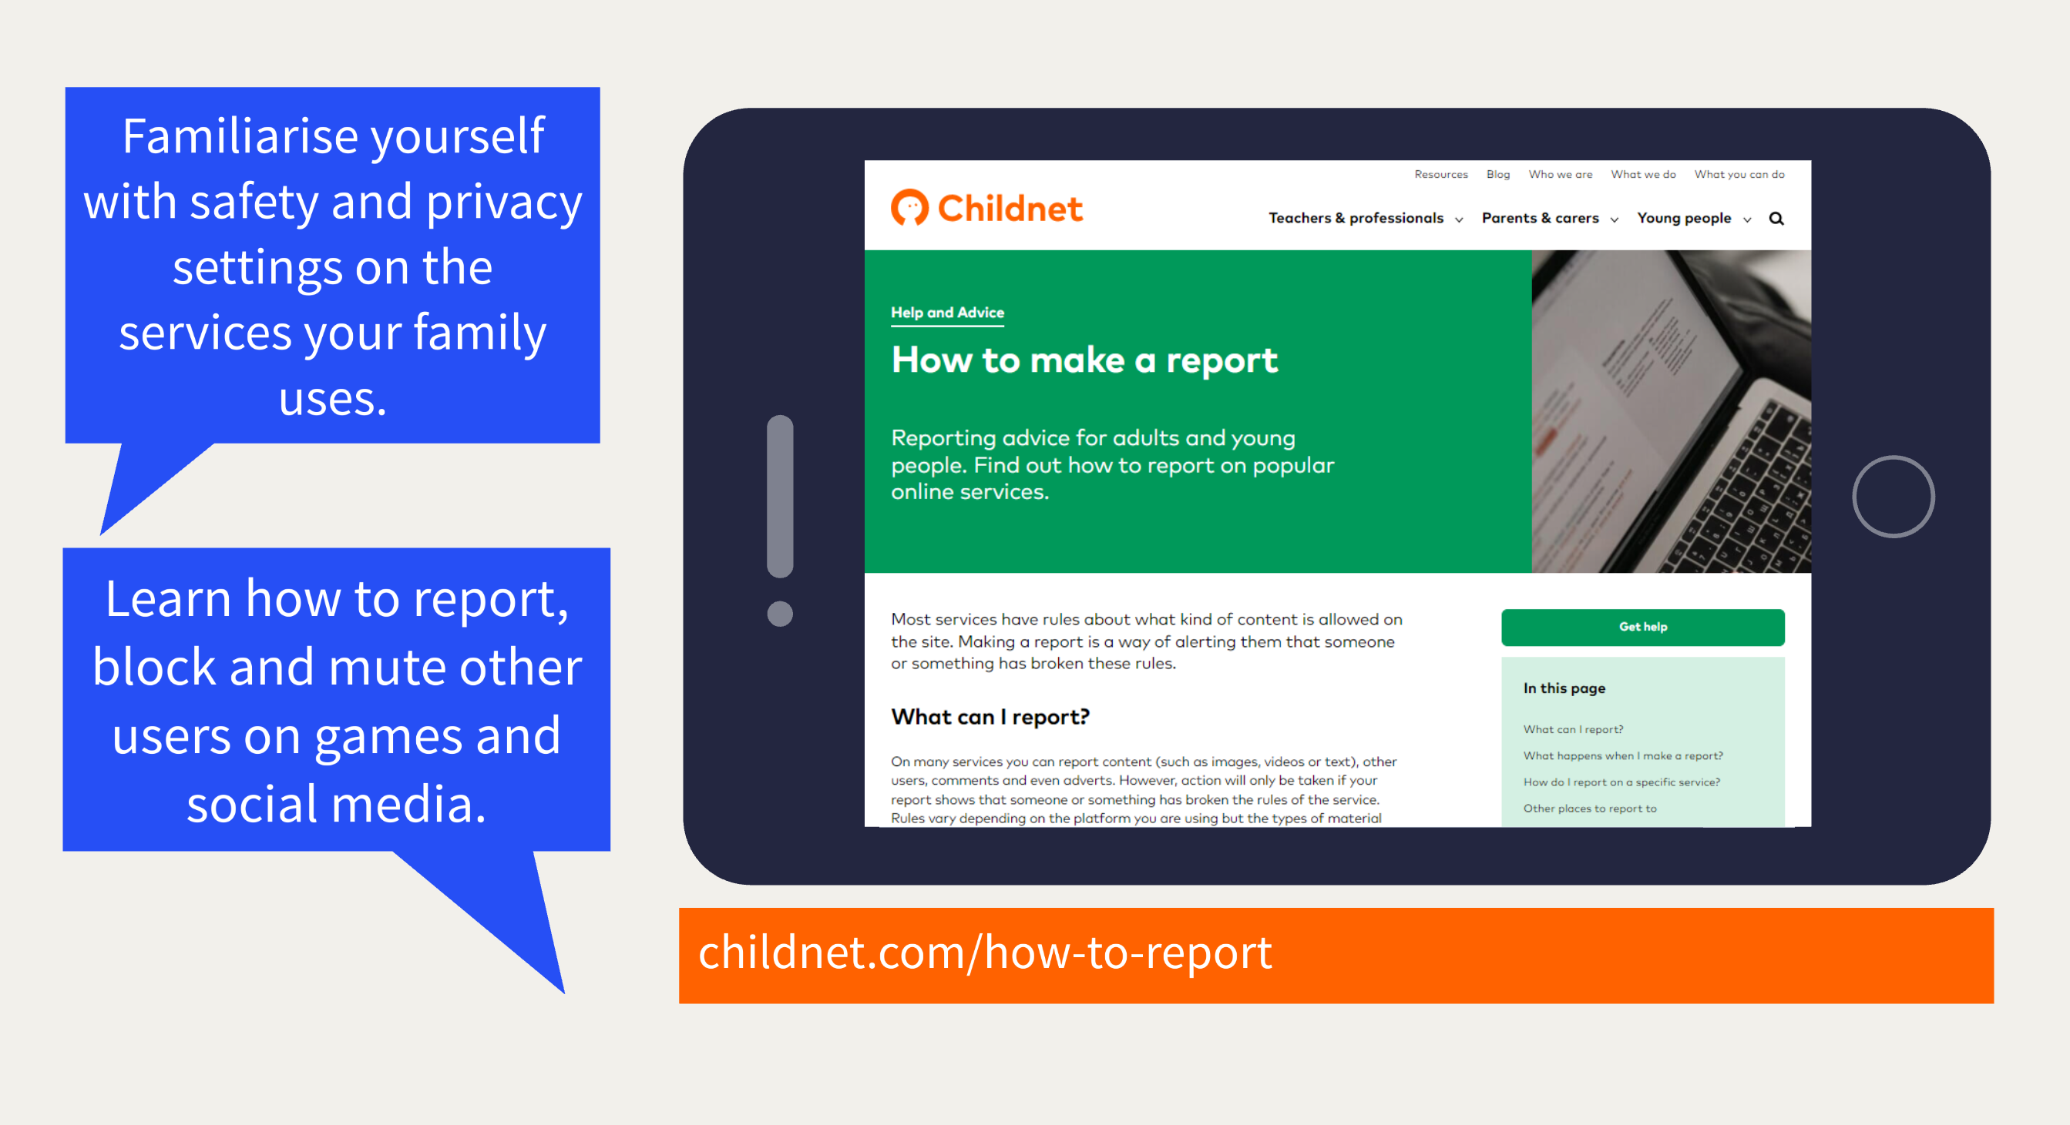

Slide 13
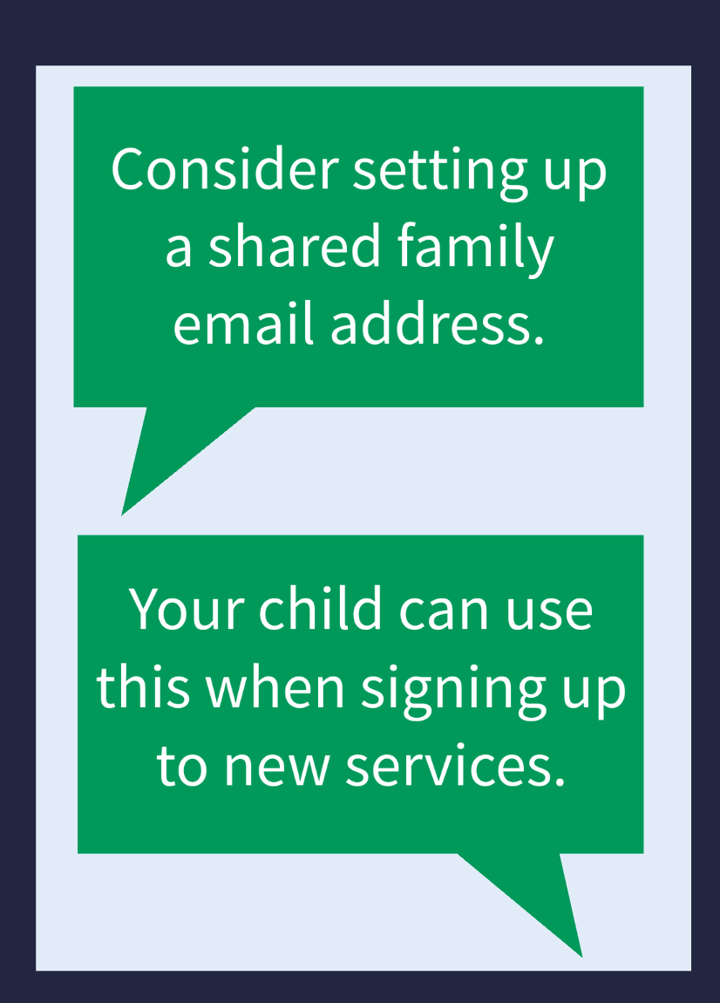
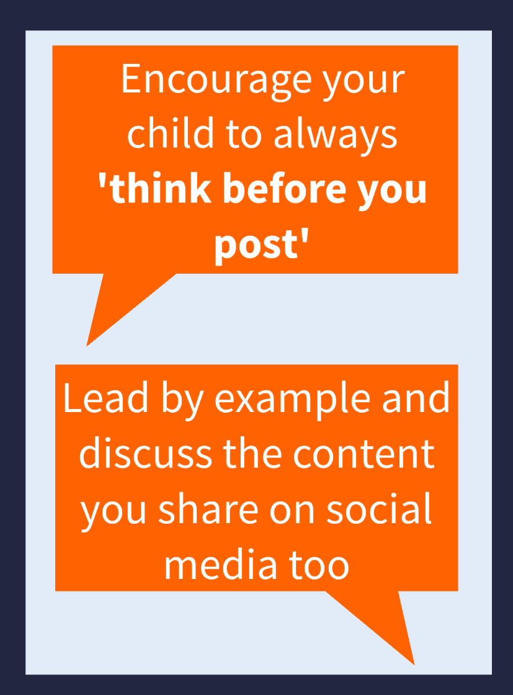
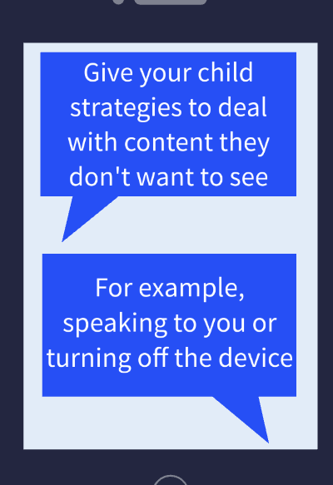

Slide 16
Other useful resources
Commonsensemedia.org
Askaboutgames.com
Reportharmfulcontent.com
Ceop.police.uk
Childnet.com/parents-and-carers
https://saferinternet.org.uk/guide-and-resource/parents-and-carers

